Slide 1


Slide 2
APEX Plugins - How to start
APEX Connect, 23-APR-2024
Moritz Klein, Senior Principal Consultant

Slide 3
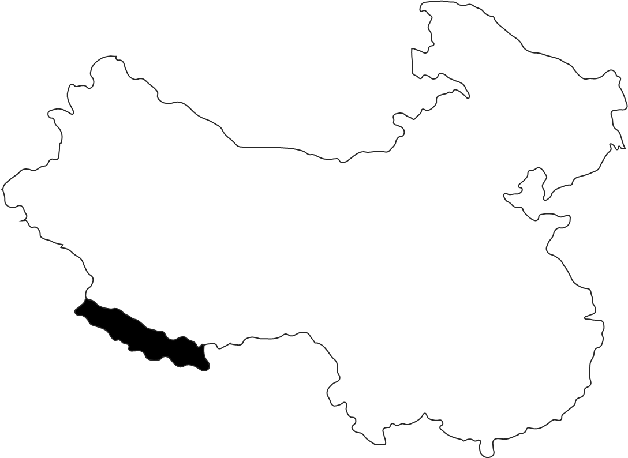
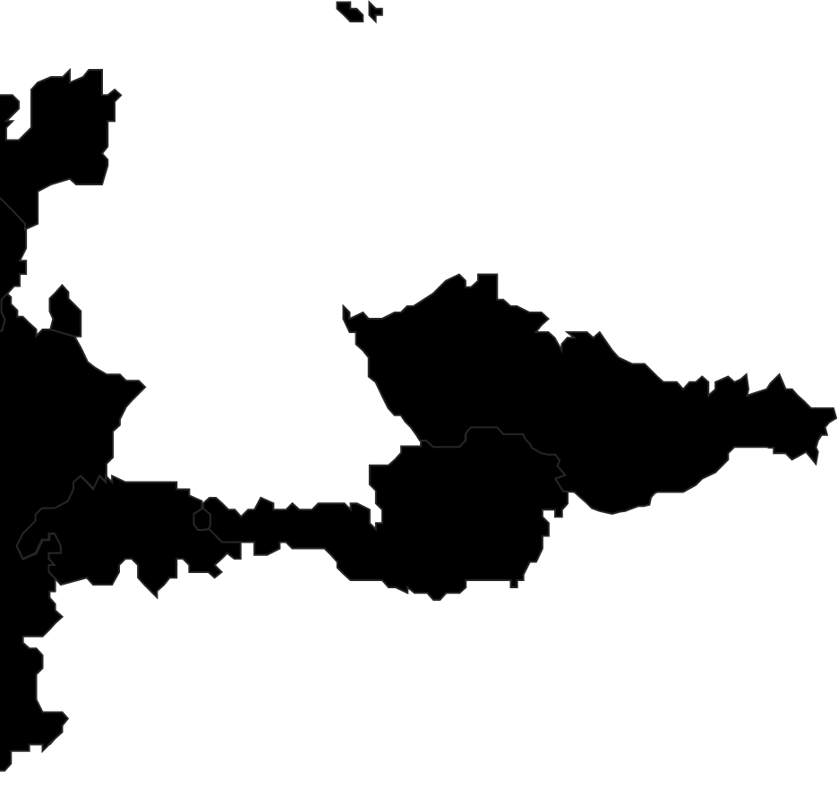


Kaunas
Vilnius
Hamburg
Berlin
Two become
Wolfsburg
Braunschweig
Ranked among the top 15 IT service providers in Germany
Dortmund
Ratingen
Wrocław
Cologne
Frankfurt
Ingolstadt
Munich
Pune
> 900 Employees (of which 160 in shoring locations)
> 150 Clients
> 10 Industries
16 Locations
Notes:
2 minutes

Slide 4
APEX Plugins - Why
Create reusable components
Enhance maintainability
Easily share
Good Practices
BORING!
Notes:
10 minutes

Slide 5
APEX Plugins – Why (Second Try)
It is fun to learn something new
Reusable Components aren't boring
It's another tool we can use
Helps to understand third-party plugins

Slide 6
APEX Plugins - When
You keep repeating yourself
You add ten different things for one functionality
Enhance the toolbox for your team
Enhance the toolbox for the community

Slide 7







400+ technical experts helping peers globally
The Oracle ACE Program recognizes and rewards community members for their technical and community contributions to the Oracle community
3 membership tiers
Nominate yourself or someone you know:
ace.oracle.com/nominate
For more details on Oracle ACE Program:
ace.oracle.com
Connect:
aceprogram_ww@oracle.com
Facebook.com/OracleACEs
@oracleace

Slide 8
APEX Plugins – Example 1
Simple Dynamic Action Plugin
Store and Retrieve Browser Scroll Position
Mostly JavaScript

Slide 9
APEX Plugins – Example 2
Simple Item Plugin
Read-Only Item
Copy to Clipboard
PL/SQL & JavaScript

Slide 10
APEX Plugins – Example 3
Dynamic Action Plugin
Interactive Grid
Multi-Row Updates
JavaScript & PL/SQL

Slide 11
APEX Plugins - Resources
PL/SQL API Documentation
APEX_PLUGIN
APEX_PLUGIN_UTIL
JavaScript API Documentation
APEX App Builder User's Guide
Implementing Plug-ins

Slide 12


Slide 13

Moritz.Klein@hyand.com
Say Hy_

